Slide 1
CUSTOMER SERVICE
PREPARED BY:
Udusanze Adelaide

Slide 2
KEYS TO A SUCCESSFUL SESSION!
Please turn all electronic devices to vibrate
Go outside if you need to take an urgent call
Share your knowledge or experience
Active listening without interruption
Please limit sidebar conversations
Change the view, not the person
Training will start on time after breaks
Have FUN!

Slide 3
OVERVIEW
What is Customer Service?
What is Customer Service Cycle?
What are the Customer Needs?
Who is responsible for Customer Service?
Who are our Customers?
Personal Cleanliness and Manners
Services Vs Goods?
What is Customer Satisfaction?
Customer Service vs Customer Satisfaction
How to improve Customer Satisfaction
What is exceptional/poor Customer Service?
Exceptional Customer Service characteristics.

Slide 4
CUSTOMER SERVICE
Customer service can be defined as the following:
Assistance and advice provided by a company to people who buy or use its products or services.
The art of ensuring the best service to customers while they are engaged in the company’s services or goods.
An act of taking care of customer needs by providing and delivering professional, helpful, high-quality service and assistance before, during, and after the customer's requirements are met.
Notes:
Ask Participants to complete the question in their lead discussion:
How do you define customer service?
Why is good customer service important?
Why do you think providing good customer service is so difficult?
What do you hear more about good customer service or bad customer service?
Why do you think that is?

Slide 5
CUSTOMER NEEDS
Customer Needs are the motivations that make someone want to purchase a product or service and stay loyal to that business.
Main Types of Customer Needs:
1. Fairness: Customers must feel that they’re getting adequate attention and fair and reasonable answers.
2. Friendliness: This is the most basic customer need that’s associated with things like courtesy and politeness. Friendly agents are a top indicator of a good customer experience.
3. Empathy: Customers need to know the organization understands and appreciates their needs and circumstances.
4. Control: Customers want to feel like they have an influence on the outcome. You can empower your customers by listening to their feedback and using it to improve.
5. Alternatives: Customers want choice and flexibility from customer service; they want to know there is a range of options available to satisfy them.
6. Information: Customers want to know about products/services; too much info and selling can be off-putting for them. A knowledge base is a great way to provide existing customers with the information they need when they need it.
7. Time: Customers’ time is valuable, and organizations need to treat it as such. Most customers said resolving their issues quickly is the top component of a good customer experience.

Slide 6
WHO IS RESPONSIBLE FOR CUSTOMER SERVICE?
Everybody in the organization is responsible for providing customer service.

Slide 7
WHO ARE OUR CUSTOMERS?
EXTERNAL CUSTOMERS: An external customer is anyone who purchases products or services from your business. They could be individual consumers, businesses, or other organizations.
External customers are essential because they provide the revenue that allows your business to stay afloat and grow. As a result, it’s important to put their needs first and ensure that they have a positive experience when dealing with your company.
By understanding their wants and needs, you can create products and services that will meet their expectations and keep them coming back for more.
INTERNAL CUSTOMERS: An internal customer is a person or department within your organization that relies on products and services provided by other departments in order to do their job. This could include anything from ordering materials for production to requesting administrative support.
However, it isn’t just other departments that could be your internal customers. Other internal customers could include Employees, Suppliers, Shareholders, and Stakeholders.

Slide 8
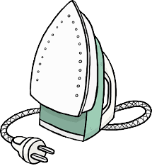
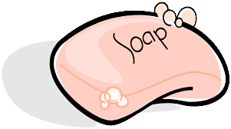
PERSONAL CLEANLINESS AND MANNERS
Personal hygiene:
Clean, and ironed uniforms including badges.
Clothing – appropriate to the situation.
Hair – combed or comfortable style.
Accessories – wear an adequate amount of jewelry, earrings, and perfume.
Expression & Composure:
Facial expressions: friendly with a polite smile.
Tone of voice: calm, patient and confident.
Body language:
Welcoming- Steady, straight and poised posture.
Surrounding:
Keep your area clean and fresh: No messy desk, fresh watered flowers in the vase or late lunch on the desk.

Slide 9
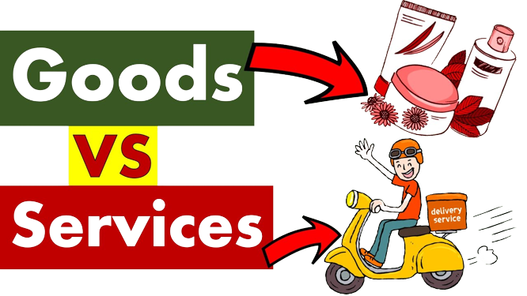
GOODS VS SERVICES
Goods imply a tangible commodity or product, which can be delivered to the customer. It involves the transfer of ownership and possession from the seller to the buyer. When a consumer purchases goods by paying their price, they have ownership of that good; hence, then possession of that particular good goes from the seller to the buyer.
On the other hand, services allude to intangible activities which are separately identifiable and provide the satisfaction of wants. Additionally, services are activities or benefits one party offers to another. It is basically some work that a person/persons do for another person. These activities can be performed by other people, companies, and others perform on your behalf.

Slide 10
CUSTOMER SERVICE SATISFACTION?
Customer satisfaction refers to how well you, as a product or service provider, fulfil the needs and expectations of your customers. This applies to any interactions before and after the sale as well as during it.
In other words: “A measure of how happy customers feel when they do business with a company.”
Notes:
Ask Participants to talk :
When we talk customer service we forget that that’s just one small segment of the whole experience and we need to focus on the end game of overall satisfaction for our customers. Just walking in the door does not constitute satisfaction, it’s a whole process the customer has to go through that begins with the customer service puzzle piece. It shouldn’t end with this small piece; it needs to be brought to fruition to complete satisfaction for that customer.
How does it make you feel when you receive :
Negative feedback about the services you provide to your customer
Positive feedback about the services you provide to your customer
What are some of the characteristics of Good Customer Service – What makes it exceptional?
Great we are going to talk more about that as we go through this presentation
We are striving to provide our customers with exceptional quality service.
What is the purpose of Customer Service?

Slide 11
CUSTOMER SERVICE vs CUSTOMER SATISFACTION
Customer Service
Happens during interaction (in person, phone, email, etc.)
Action/Cause
Customer Satisfaction
Happens after customer receives service and has their needs met.
Reaction/Effect
vs.
Notes:
Ask Participants the difference:
The goal of successful business is to satisfy the customer above all else
2. The end game for all businesses has got to be customer satisfaction, while customer service is the art of ensuring your giving the best service to your customers while they are in your stores, it’s the goal that you’re completely and over and above satisfy that customer as they leave your business. This is the ultimate litmus test in determining whether they (the customer) will be coming back or referring your business to a family member or friend.
customer service leads to customer satisfaction. The most critical are, warmly acknowledge the customer, build trust and rapport, identify needs, and satisfactorily resolve issues and concerns, expressing gratitude for the opportunity to serve the customer.

Slide 12
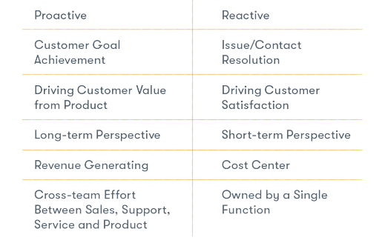
CUSTOMER SATISFACTION vs CUSTOMER SERVICE
Customer Satisfaction
Customer Service
Notes:
Ask Participants the difference:
The goal of successful business is to satisfy the customer above all else
2. The end game for all businesses has got to be customer satisfaction, while customer service is the art of ensuring your giving the best service to your customers while they are in your stores, it’s the goal that you’re completely and over and above satisfy that customer as they leave your business. This is the ultimate litmus test in determining whether they (the customer) will be coming back or referring your business to a family member or friend.
customer service leads to customer satisfaction. The most critical are, warmly acknowledge the customer, build trust and rapport, identify needs, and satisfactorily resolve issues and concerns, expressing gratitude for the opportunity to serve the customer.

Slide 13
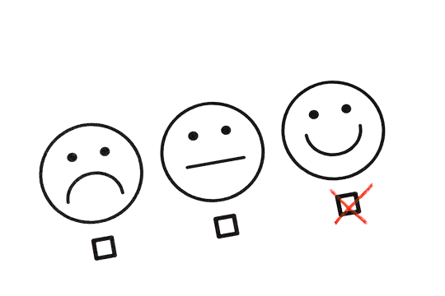
7 TECHNIQUES TO IMPROVE CUSTOMER SATISFACTION
1. Understand your customer journey prior to you serving them.
2. Listen to your customers attentively.
3. Offer proactive multi-channel support.
4. Act on customer feedback and do not take anything personally.
5. Personalize your user experience in a most friendly and professional manner.
6. Conduct often, simple customer satisfaction surveys to improve either procedures or rendered services.
7. Creatively follow up with your customers!

Slide 14
WHAT IS AN EXCEPTIONAL/POOR CUSTOMER SERVICE?
Poor Customer Service:
Exceptional Customer Service:
Act of going above and beyond what the customer expects
Taking that extra step to make them feel that you understand what they are going through
Displaying that you want this to be the best experience they have ever had.
Failure to respond to customer queries and complaints on rendered services;
Anything below the customer's expectation;
Long uncommunicated waits;
Being transferred to different teammates multiple times;
Poor and unwelcoming automated phone prompts;
Lack of Empathy and support;
Delay in emails reply and missed calls returns.
Notes:
anything below customer's expectation means poor customer service to them. To measure , we must know the customer’s expectation
Notice anything… if it’s vague (poor)

Slide 15
EXCEPTIONAL CUSTOMER SERVICE CHARACTERISTICS
Positive Attitude
Patience
Professionalism/Politeness
Responsiveness
Problem-Solving
Initiative
Team Player
Accountability
Respect
Stewardship
Compassion
Persuasive
Intentional Excellence

Slide 17
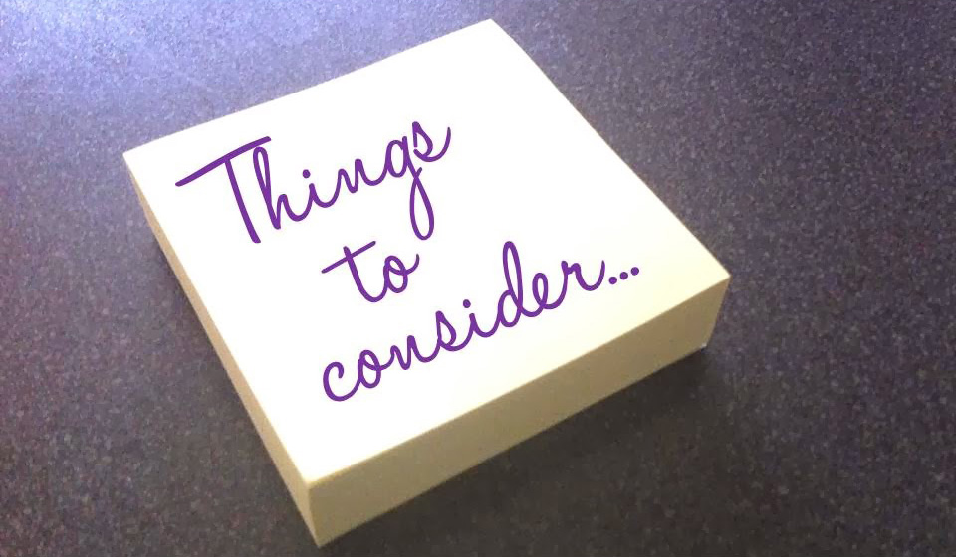
TAKE AWAY
Notes:
Ask participants:
What simple things could you and your team do today to start positively affecting the customer experience?
And how can you make sure the entire team (state and partner staff) on board know about Customer Service?
What are one or two things you’ve learned today that you will start using immediately to better assist customers when you return to your office?

Slide 18
Q&A Session!
Notes:
All…

